Slide 1
CMSC201
Computer Science I for Majors
Lecture 02 – Algorithmic Thinking

Slide 2
Last Class We Covered
Syllabus
  Grading scheme, expectations, etc.
  Academic Integrity Policy
    (Collaboration Policy)
Binary numbers
  Converting between binary and decimal
Algorithmic thinking
  Making sandwiches for aliens

Slide 3
Any Questions from Last Time?

Slide 4
Today’s Objectives
To practice thinking algorithmically
To understand and be able to implement proper program development
To start learning about control structures
To be able to express an algorithm
using a flow chart

Slide 5
What is an Algorithm?
Steps used to solve a problem
Problem must be
  Well defined
  Fully understood
  by the programmer
Steps must be
  Ordered
  Unambiguous
  Complete

Slide 6
Developing an Algorithm

Slide 7
Program Development
Understand the problem
Represent your solution (your algorithm)
  Pseudocode
  Flowchart
Implement the algorithm in a program
Test and debug your program

Slide 8
Step 1: Understanding the Problem
Input
  What information or data are you given?
Process
  What must you do with the information/data?
  This is your algorithm!
Output
  What are your deliverables?

Slide 9
“Weekly Pay” Example
Create a program to calculate the
weekly pay of an hourly employee
  What is the input, process, and output?
Input: pay rate and number of hours
Process: multiply pay rate by number of hours
Output: weekly pay

Slide 10
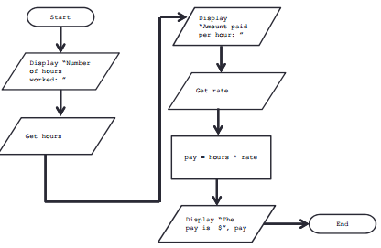
Step 2: Represent the Algorithm
Can be done with flowchart or pseudocode
Flowchart
  Symbols convey different types of actions
Pseudocode
  A cross between code and plain English
One may be easier for you – use that one

Slide 11
Flowchart Symbols
Start
Start Symbol
Input/Output
End
End Symbol
Decision Symbol
Data Processing Symbol
Flow Control Arrows

Slide 12
Step 2A: Flowchart
Start
Get the rate
Display “Number
of hours worked: ”
pay = hours * rate
Get the hours
Display “The pay
is $” , pay
Display “Amount
paid per hour: ”
End

Slide 13
Step 2B: Pseudocode
Start with a plain English description, then…
Display "Number of hours worked: "
Get the hours
Display "Amount paid per hour: "
Get the rate
Compute pay = hours * rate
Display "The pay is $" , pay

Slide 14
Steps 3 and 4: Implementation and Testing/Debugging
We’ll cover implementation in detail next class
Testing and debugging your program involves identifying errors and fixing them
  We’ll talk about this later today

Slide 15
Algorithms and Language
Notice that developing the algorithm
didn’t involve any Python at all
  Only pseudocode or a flowchart was needed
  An algorithm can be coded in any language
All languages have 3 important tools called control structures that we can use in our algorithms

Slide 16
Control Structures

Slide 17
Control Structures
Structures that control how the program “flows” or operates, and in what order
Sequence
Decision Making
Looping

Slide 18
Sequence
One step after another, with no branches
Already wrote one for “Weekly Pay” problem
What are some real life examples?
  Dialing a phone number
  Purchasing and paying for groceries

Slide 19
Decision Making
Selecting one choice from many based
on a specific reason or condition
  If something is true, do A … if it’s not, do B
What are some real life examples?
  Walking around campus (construction!)
  Choosing where to eat lunch

Slide 20
Decision Making: Pseudocode
Answer the question “Is a number positive?”
  Start with a plain English description
Display "Enter the number: "
Get the number (call it num)
If num < 0
Display "It is negative"
Else
Display "It is positive"

Slide 21
Decision Making: Flowchart
Start
Display “Enter
the number: ”
Get the
number
TRUE
num < 0
FALSE
Display
“It is negative”
Display
“It is positive”
End

Slide 22
Looping
Doing something over and over (and over) again
Used in combination with decision making
  Otherwise we loop forever
    This is called an “infinite loop”
What are some real life examples?
  Doing homework problem sets
  Walking up steps

Slide 23
Looping: Pseudocode
Write an algorithm that counts from 1 to 20
  Start with a plain English description
Set num = 1
While num <= 20
Display num
num = num + 1
(End loop)

Slide 24
Looping: Flowchart
Start
num = 1
There’s an error in this flowchart… do you see it?
num >= 20
TRUE
Display num
num = num + 1
FALSE
End

Slide 25
Looping: Flowchart
Start
num = 1
This type of error is called a “bug,” and finding and fixing bugs is called “debugging”
num <= 20
TRUE
Display num
num = num + 1
FALSE
End

Slide 26
Debugging

Slide 27
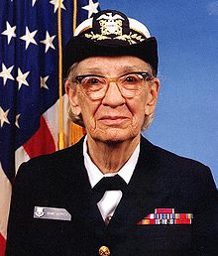
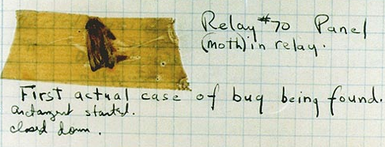
A Bit of History on “Bugs”
US Navy lab – September 9, 1947
Grace Hopper and her colleagues were working on the Harvard Mark II
  Or trying to… it wasn’t working right
They found a literal bug inside the machine
  Taped the bug (a moth)
  into their log book
Rear Admiral Grace Hopper
Images from wikimedia.org
Notes:
https://commons.wikimedia.org/wiki/File:Grace_Hopper.jpg
https://commons.wikimedia.org/wiki/File:H96566k.jpg

Slide 28
Errors (“Bugs”)
Two main classifications of errors
Syntax errors
  Prevent Python from understanding what to do
Logical errors
  Cause the program to run incorrectly, or to
  not do what you want

Slide 29
Syntax Errors
“Syntax” is the set of rules followed by a computer programming language
  Similar to grammar and spelling in English
Examples of Python’s syntax rules:
  Keywords must be spelled correctly
    True and False, not Ture or Flase or Truu
  Quotes and parentheses must be closed:
    ("Open and close")

Slide 30
Syntax Error Examples
Find the syntax errors in each line of code below:
  1 prnit("Hello")
  2 print("What"s up?")
  3 print("Aloha!)
  4 print("Good Monring")

Slide 31
Syntax Error Examples
Find the syntax errors in each line of code below:
  1 prnit("Hello")
  2 print("What"s up?")
  3 print("Aloha!)
  4 print("Good Monring")
not actually a syntax error

Slide 32
Logical Errors
Logical errors don’t bother Python at all…
they only bother you!
Examples of logical errors:
  Using the wrong value for something
    currentYear = 2013
  Doing steps in the wrong order
    “Close jelly jar. Put jelly on bread. Open jelly jar.”

Slide 33
Exercise
Write an algorithm that asks a user for their name, then responds with “Hello NAME”
You can use a flowchart or pseudocode
Start
Input/Output
Decision
End
Data Processing
Flow Control

Slide 34
Exercise #2
Write an algorithm that asks a user for their grade, and tells them their letter grade.
  A: 100 - 90 C: <80 - 70 F: <60 - 0
  B: <90 - 80 D: <70 - 60
Start
Input/Output
Decision
End
Data Processing
Flow Control

Slide 35
Announcements
Lab 1 is an online lab this week
  Due by Thursday @ 8:59:59 PM
Labs will meet in person starting next week
Homework 1 will be out Wednesday night
  Due Wednesday (September 14th) at 8:59:59 PM
  You must complete the “Syllabus and Course Website Quiz” before being able to access it
  Both of these assignments are on Blackboard

